Slide 1
Group MidTerm Project: Designing a Cloud Solution
A Medical Company Startup
SHRIYA SURUSANI, CHAITANYA GAWADE
Group 5

Slide 2
Customer Requirements
The requirements include:
Configuring access permissions to conform with AWS best practices.
Building networks that conform to AWS best practices while providing all the necessary network services to the application in their different environments.
Building an architecture that matches the current architecture at the server hosting company and that can handle doubling the number of servers.
Securing all medical information, as medical information usually contains highly sensitive personally identifiable information (PII).
Utilizing load balancers for web tier and application tier that must support HTTP, HTTPS, TCP protocols plans to move their application into AWS.
Architecture should be resilient (built for business continuity).
Configuring auditing to track all user actions.

Slide 3

Identifying AWS Services
Virtual Private Cloud(VPC) - Service that lets you launch AWS resources in a logically isolated virtual network.
Amazon EC2 - web service that provides secure, scalable compute capacity in the cloud.
Elastic Load Balancing - automatically distributes incoming application traffic across multiple targets.
NAT Gateway - instances in a private subnet can connect to services outside your VPC but external services cannot initiate a connection with those instances.
Amazon RDS - provides cost-efficient and resizable capacity while automating time-consuming administration tasks such as hardware provisioning, database setup, patching and backups.
Security Group - acts as a virtual firewall for your instance to control inbound and outbound traffic.
Auto Scaling Group - monitors your applications and automatically adjusts capacity to maintain steady, predictable performance at the lowest possible cost.
_________________________________________________
Services needed and the purpose for each service that will be used to move A Medical Company’s current environment to AWS.

Slide 4
User Authentication: User Groups/Roles
A Medical Company Account
System Admin Group
DB Admin Group
Monitoring Group
Roles
Sys Admin 1
DB Admin 1
User 1
Administrator
Sys Admin 2
DB Admin 2
User 2
Auditor
User 3
ServerS3_Access
User 4

Slide 5
User Authentication: Group/Role Permissions
Group/Role # | Group/Role Name | Permissions
Group | System Admin | All
Group | DB Admin | R/W S3, RDS
Group | Monitoring | R EC2, S3, RDS
Role | Administrator | All
Role | Auditor | R CloudWatch, CloudTrail, Athena
Role | ServerS3_Access | R/W S3, EC2

Slide 6
User Authentication: Authentication Requirements
Requirement | Solution
Should be at least 8 characters and have 1 uppercase, 1 lowercase, 1 special character, and a number. | In IAM Management Console, we select "Password Policy" and then check the required conditions.
Change passwords every 90 days and ensure that the previous three passwords can’t be re-used. | In IAM Management Console, we select "Password Policy" and then select "Password Expiration" and set it to 90 days.
All administrators require programmatic access | While we’re creating users for an administrator group, we select AWS Access type as "Programmatic Access".
Administrator sign-in to the AWS Management Console requires the use of Virtual MFA. | We log into AWS Management Console, choose "My Security Credentials" under account name on the navigation bar, and then select MFA and activate it.

Slide 7



Old Architecture
Production Network
Web Tier –
2 CPUs,
4-GB memory,
MS Windows
Web Tier –
2 CPUs,
4-GB memory,
MS Windows
App Tier –
4 CPUs,
16-GB memory,
MS Windows
App Tier –
4 CPUs,
16-GB memory,
MS Windows
Database Tier –
8 CPUs, 32-GB memory, 5-TB storage,
MS Windows, SQL Server SE

Slide 8
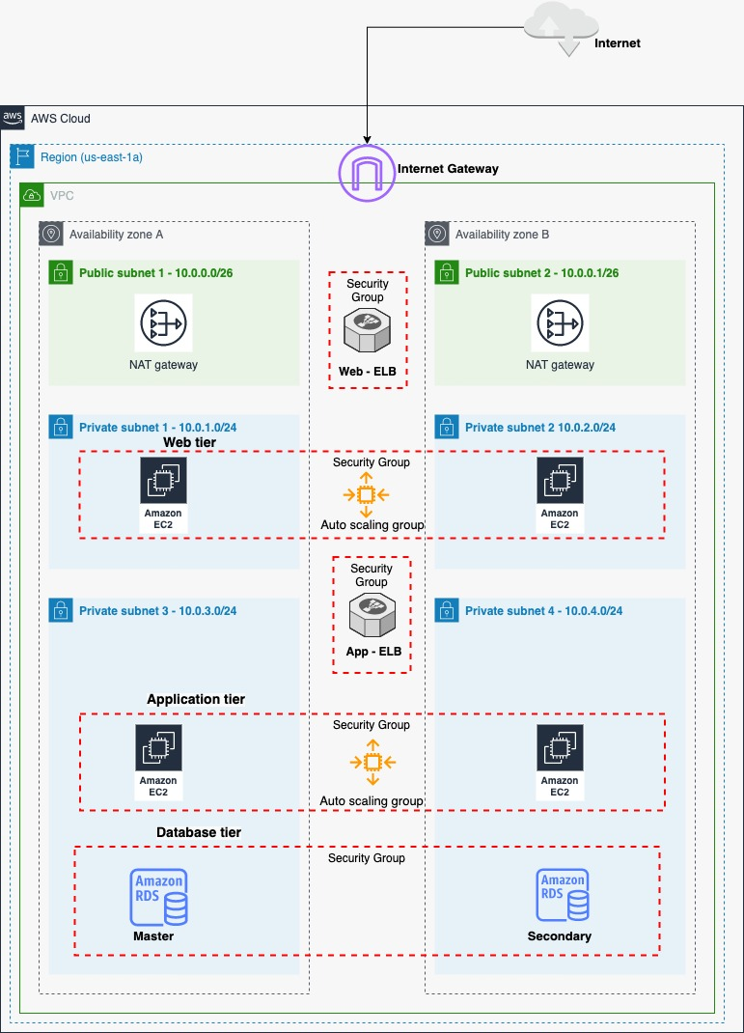
New Architecture
Production Network

Slide 9
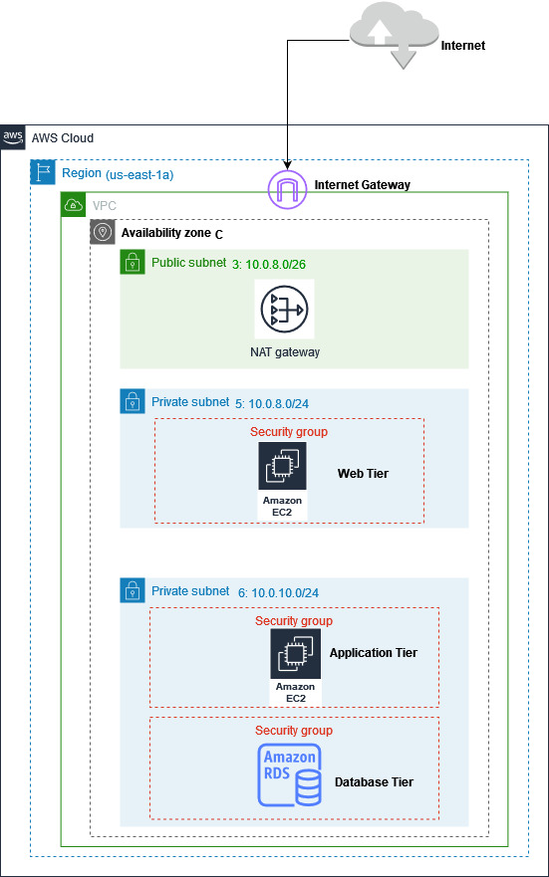
New Architecture
Dev/Test Network

Slide 10
Network and Security
VPC solution
VPC | Region | Purpose | Subnets | AZs | CIDR Range
1 | us-east-1a | Production | 6 | 2 | 10.0.0.0/21
2 | us-east-1a | Dev/Testing | 3 | 1 | 10.0.8.0/22

Slide 11
Network and Security
Production VPC
Subnet Name | Subnet Type (Public/private) | AZ | Subnet Address
Public Subnet 1 | Public | A | 10.0.0.0/26
Public Subnet 2 | Public | B | 10.0.0.1/26
Private Subnet 1 | Private | A | 10.0.1.0/24
Private Subnet 2 | Private | B | 10.0.2.0/24
Private Subnet 3 | Private | A | 10.0.3.0/24
Private Subnet 4 | Private | B | 10.0.4.0/24

Slide 12
Network and Security
Dev/Testing VPC
Subnet Name | Subnet Type (Public/private) | AZ | Subnet Address
Public Subnet 3 | Public | C | 10.0.8.0/26
Private Subnet 5 | Private | C | 10.0.8.0/24
Private Subnet 6 | Private | C | 10.0.10.0/24

Slide 13
Web and Application Tier
EC2/ RDS Instances
Tier | Tag | OS | Type | Size | Justification | # of instances | User Data?
Web | Key = Name Value = web-tier | MS Windows | t3 | medium | t3 medium matches original computer specs and has better network capacity than t2 | 2 | CloudWatch, EC2, AutoScaling, IIS, WMT
App | Key = Name Value = app-tier | MS Windows | t3 | xlarge | t3 xlarge matches original computer specs and has better network capacity than t2 | 2 | CloudWatch, EC2, AutoScaling, IIS, WMT
DB | Key = Name Value = db-tier | MS Windows, SQL Server SE | db.t3 | 2xlarge | This matches the current hardware solution requirements and is EBS Optimized, Enhanced Networking | 2 | CloudWatch, RDS

Slide 14
Web and Application Tier
Load balancers and security group details for EC2/RDS instances
Load Balancer | Name | External/Internal | Subnets | SG Name | Rule | Source
For Web Tier (ALB) | Web-ELB | External | Private Subnet 1 Private Subnet 2 | web-elb-sg | protocol: TCP,HTTP/S port: 443,80 | 0.0.0.0/0
For App Tier(NLB) | App-ELB | Internal | Private Subnet 3 Private Subnet 4 | app-elb-sg | protocol: TCP,HTTP/S port: 8080, 443 | web-tier-elb-sg, app-elb-sg
Instance Tier | SG Name | Rule | Source
Web Tier | web-tier-sg | protocol: TCP,HTTP/S port: 80, 443 | web-elb-sg
App Tier | app-tier-sg | protocol: TCP,HTTP/S port: 80 | app-elb-sg
Database Tier | db-tier-sg | protocol: TCP,HTTP/S port: 443 | app-tier-sg

Slide 15
Business Continuity
Automatic scaling launch configuration.
Tier | OS | Type | Size | Configuration Name | Role | Security Group
Web | MS Windows | t3 | medium | Web Tier | ServerS3_Access | Web-ELB
App | MS Windows | t3 | xlarge | Application Tier | ServerS3_Access | App-ELB

Slide 16
Business Continuity
Automatic scaling groups
Tier | Launch Configuration | Group Name | Group Size | VPC | Subnets | ELB
Web | WebTier | Web Tier | MinSize=2 MaxSize=4 | 1 | Private Subnet 1 Private Subnet 2 | Web-ELB
App | AppTier | Application Tier | MinSize=2 MaxSize=4 | 1 | Private Subnet 3 Private Subnet 4 | App-ELB

Slide 17
Auditing
Service | Why do we need it
CloudTrail | It will track event history from last 90 days and includes users, action and time
CloudWatch | It will log API history beyond 90 days
Athena | Provides query service for log data
S3 | Will secure log storage
AWS KMS | Will encrypt logging data

Slide 18
THANK YOU

